Slide 1


SAP S/4HANA Training
MASTER DATA GOVERNANCE (SAP MDG)
Neeraj Gupta
Session 26
SAP MDG – Performance Optimization,

Slide 2
Performance improvements
26
SAP MDG – Performance
MDG Functions to be considered for improving Performance
Parallel processing during data import/export
Periodic deletion of status logs using Transaction DRFRSDEL (Program RDRF_ DELETE_REP_STA)
File upload performance issue (Restrict file size to 10K)
Business rules in SAP Master Data Governance
Periodic deletion of logs using Transaction DRFLOGDEL (Program RDRF_DELETE_ LOG)
Periodic deletion using Transaction MDGCPDEL (Program MDG_BS_CHANGE_POINTER_TOOLS)
Data replication trigger using Transaction DRFOUT
Data replication trigger program USMD_EDITION_REPLICATE
Data virus scan profile in SAP Fiori for SAP Master Data Governance applications (Virus scan profile MDG_BS_FILE_UPLOAD/MDG_VSCAN)
Hardware requirements (Sizing guidelines)
Application configuration and user interface building block (UIBBs)
Highlighting changes
Floorplan Manager (Buffering activation of table FPM_ADAPT_SET)

Slide 3
Performance improvements
26
SAP MDG – Performance
Hardware Requirements and System Performance
e.g. With less than 10 active users running 200 processes per hour, you would need approximately 5GB of memory
Reference System
Measurements using transaction STAD
• Response Time: Is the total response time without network and rendering efforts.
• CPU Time: Should be the biggest block in terms of response time.
• DB Req. Time: MDG-M has a very healthy relation to database runtime. The value here should be 10% or less in relation to the given CPU time.
• Overhead: The waiting time and roll processes are defined here as “overhead”. You can calculate them by subtracting CPU and DB time from Response Time. The relation should be 5-10% maximum

Slide 4
Performance improvements
26
SAP MDG – Performance
Native System or Virtual Machine
Application Configuration and UIBBs
State of Building Blocks and Lazy Load
Hierarchical UI
Governance Scope
Memory Consumption
Direct Call of OVP
Custom UIBBs
Implementation Hints
SAP Notes
Custom Code

Slide 5
Read Access Logging Framework
26
SAP MDG – Performance
Use Case: SAP Master Data Governance, as an application that manages and governs personal and sensitive data, is required to comply with data privacy regulations. Helps to keep trace / log of data access (Data Privacy / Data protection)
Detect Fraud
Prevent Data theft
Auditing
Functions and interfaces use based on logging data classification
Logging Purpose: is an attribute to classify logging data
Define and assign to each log entry as an attribute
Archiving rules can be based on logging purpose / classification of log data
Reports can be created based on logging purposes

Slide 6
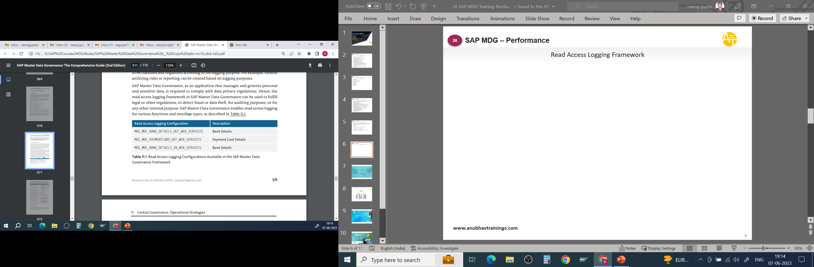
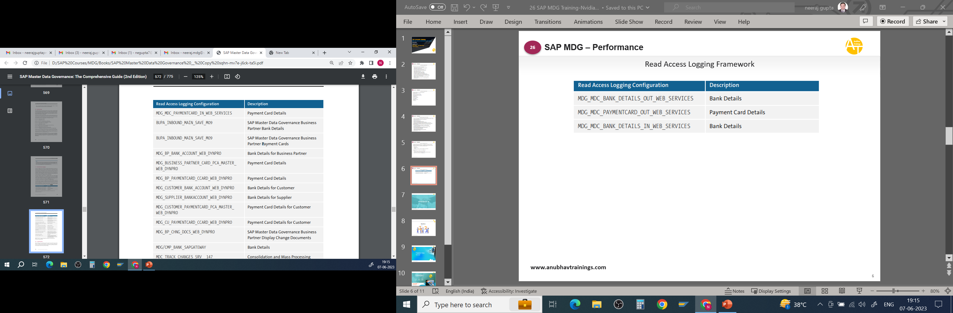
Read Access Logging Framework
26
SAP MDG – Performance

Slide 7
Performance improvement Checklist
26
SAP MDG – Performance
What is the specification of your reference system (if applicable: number of SAPS)
What type of system (development, test, productive)?
Native or virtual system?
Which MDG release is used?
Did you test your installation like proposed
What are the results in runtime for the given example?
How long does the application start take for the overview screen (OVP)?
With standard SAP configuration (Change Request and Basic Data expanded,
others are collapsed)
With custom configuration? Please name the UIBBs expanded as well.
Is the application configuration modified in your implementation?
Are custom UIBBs added?
Which implementation hints did you consider for your custom UIBB?
Did you check the implementation hints for custom code?
If you face performance issues, did you…
Update the kernel to the latest patch?
Import the latest NetWeaver/FPM support packages
Consider SAP Note 2105467

Slide 8
Root Cause Analysis
26
SAP MDG – Performance
Transactions and programs in SAP Master Data Governance for any change request failed activations and workflow-related scenarios:
Transaction SLG1: Analyze Application Log
Transaction SWIA: Process Work Item as Administrator
Transaction SWI5: Workload Analysis
Transaction SWI6: Display Workflows: Select an OBJECT
Program USMD_DELETE_MODEL
Program USMD_DELETE_CR
Transaction SWI1: Selection Report for Work Items
Transaction USMD_SSW_RULE: Rule-Based Workflow Configuration
Transaction USMD_RULE: BRFplus Rules
Transaction SWE2: Change View “Event Type Linkages”

Slide 9
Root Cause Analysis
26
SAP MDG – Performance
Common transactions and a report that can be used for troubleshooting and analysis related to data replication:
Transaction DRFRSD: Replication Status for Business Object/Receiver System
Transaction DRFLOGDEL: Reorganize DRF Logs
Report RDSF_MESSAGE_REOUT: Restart Replication for Erroneous Objects
Transaction DRFOUT: Execute Data Replication
Transaction MDGCPDEL: Reorganization of SAP Master Data Governance Change Pointer Transaction MDG_ANALYZE_IDM: Search Key Mapping
Transaction DRFSUB: Subscribe Business Objects for Replication
Transaction MDG_KM_MAINTAIN: Create and Edit Key Mapping
Transaction DRFLOG: Analyze DRF Logs
Transaction SRT_TOOLS: Web Service Utilities: Message Monitor
Transaction SRT_MONI: Web Service Utilities: Message Monitor
Transaction SXMB_MONI: Integration Engine: Monitoring
Transaction DRFIMG: Customizing for Data Replication Framework
Transaction DRFCC: Check Customizing for Data Replication Framework
Transaction DRFF: Define Filter Criteria
Transaction DRFLOG: Analyze Log for Outbound Implementations

Slide 10
Root Cause Analysis
26
SAP MDG – Performance
Transactions and a program in SAP Master Data Governance for various troubleshooting scenarios:
Transaction LPD_CUST: Overview of Launch Pads
Transaction WE21: Ports in IDOC Processing
Transaction SE80: Object Navigator
Transaction ST22: ABAP Runtime Errors
Transaction SU53: Display Authorization Data
Program USMD_EDITION_REPLICATE: Edition-Based Replication
Transaction WE19: Test Tool for IDoc Processing
Transaction AL11: SAP Directories
Transaction CG3Z: Upload File Parameters
Transaction BD54: Change View Logical Systems Overview
Transaction BD82: Generate Partner Profile
Transaction FILE: Logical File Path Definition Overview
Transaction CG3Y: Download File Parameters

Slide 11

End of Session 26

Slide 12

Questions

Slide 13

Neeraj Gupta

Slide 14


We’re committed to empower you to be
Most Desirable Resource
through powerful training solutions.
We build the workforce of the future.
250+
Corporate Clients
30,000+
Learners Trained
25000+
Learners Placed
FREE WEBINARS
Sign up for free webinars with industry experts every fortnight!
Enroll Now!
Contact us today!
https://anubhavtrainings.com/

Slide 15




More from AnubhavTrainings.com

